Slide 1
Making a Monogame
08135 – Programming Paradigms

Slide 2
Getting started on Windows 10
Install Visual Studio
Install Monogame
http://www.monogame.net/downloads/
Both these are already in the labs
You can use this installation to create games for Windows Desktop and also ones that can be published in the Windows Store

Slide 3
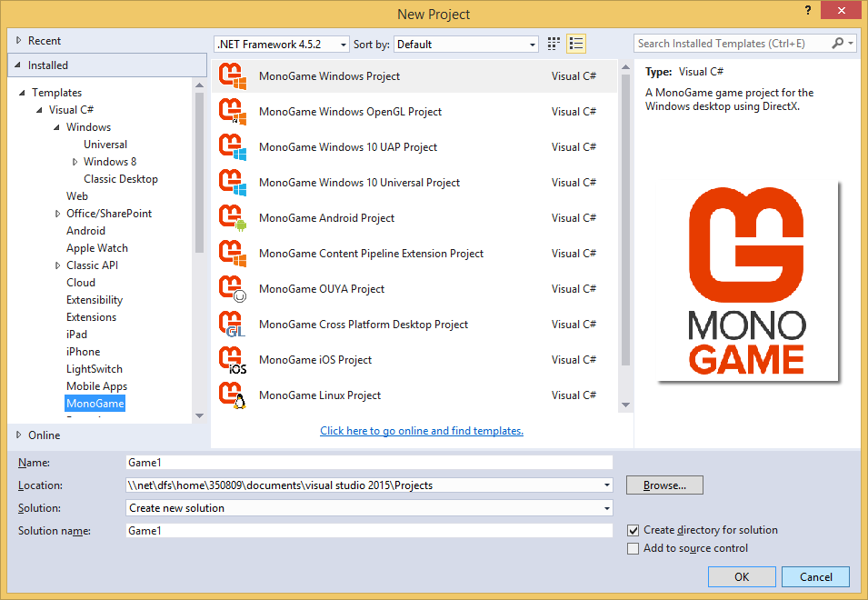
Making a new Monogame Project
Monogame adds new project types

Slide 4
Monogame Sample Applications
If you are new to development you might want to start from a sample game
These are guaranteed to work
Mostly

Slide 5
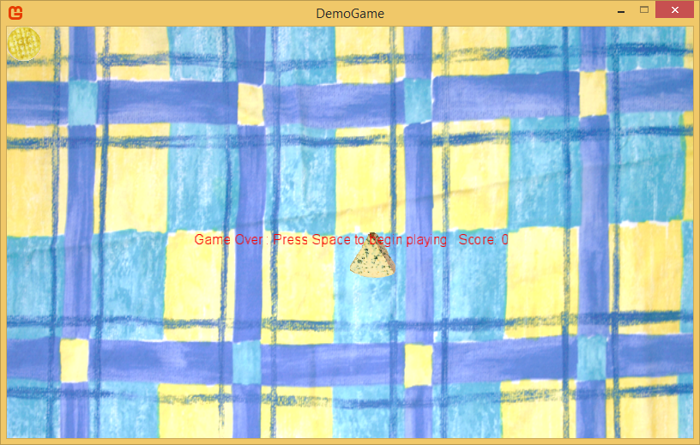
Cracker Chase
Cracker chase is not a very good game
Chase the crackers with the cheese

Slide 6
How Games Work
Every game that has ever been written has these fundamental behaviours
Initialise all the resources at the start
Fetch all textures, models, scripts, etc.
Repeatedly run the game loop:
Update the game world
Read the controllers, update the state and position of game elements
Draw the game world
Render the game elements on the viewing device

Slide 7
Cracker Chase Behaviours
The Cracker Chase game does three things
Loads the content
Updates the game
Draws the game
We can take a look at how these work

Slide 8

A Word about Sprites
A sprite is a game object that has a position and a texture
Plus a few other things
We create these to represent game objects

Slide 9
Sprite Data
This is all the data held in a standard sprite
class Sprite
{
protected int screenWidth;
protected int screenHeight;
protected Texture2D texture;
protected Rectangle rectangle;
protected float xPosition;
protected float yPosition;
protected float xResetPosition;
protected float yResetPosition;

Slide 10
Sprite Data
The size of the screen it is part of
class Sprite
{
protected int screenWidth;
protected int screenHeight;
protected Texture2D texture;
protected Rectangle rectangle;
protected float xPosition;
protected float yPosition;
protected float xResetPosition;
protected float yResetPosition;

Slide 11
Sprite Data
The texture that contains the sprite image
class Sprite
{
protected int screenWidth;
protected int screenHeight;
protected Texture2D texture;
protected Rectangle rectangle;
protected float xPosition;
protected float yPosition;
protected float xResetPosition;
protected float yResetPosition;

Slide 12
Sprite Data
The rectangle that defines the width and height of the sprite
class Sprite
{
protected int screenWidth;
protected int screenHeight;
protected Texture2D texture;
protected Rectangle rectangle;
protected float xPosition;
protected float yPosition;
protected float xResetPosition;
protected float yResetPosition;

Slide 13
Sprite Data
The X and Y position of the sprite
class Sprite
{
protected int screenWidth;
protected int screenHeight;
protected Texture2D texture;
protected Rectangle rectangle;
protected float xPosition;
protected float yPosition;
protected float xResetPosition;
protected float yResetPosition;

Slide 14
Sprite Data
The place to put it back to when the game resets
class Sprite
{
protected int screenWidth;
protected int screenHeight;
protected Texture2D texture;
protected Rectangle rectangle;
protected float xPosition;
protected float yPosition;
protected float xResetPosition;
protected float yResetPosition;

Slide 15
Creating a background sprite
This is how I make a simple sprite for the background
I want the sprite to be the width and height of the screen and placed at 0,0
Texture2D cloth = Content.Load<Texture2D>("Tablecloth");
background = new Sprite(screenWidth, screenHeight,
cloth, screenWidth, 0, 0);

Slide 16
Creating a background sprite
The game sets these values so that the game will automatically fit any sized screen
Texture2D cloth = Content.Load<Texture2D>("Tablecloth");
background = new Sprite(screenWidth, screenHeight,
cloth, screenWidth, 0, 0);

Slide 17
Creating a background sprite
The background sprite has a reset position of 0,0 so that it is displayed over the whole screen
Texture2D cloth = Content.Load<Texture2D>("Tablecloth");
background = new Sprite(screenWidth, screenHeight,
cloth, screenWidth, 0, 0);

Slide 18
List of Sprites
The game contains a list of sprites that are all the objects on the screen
Each time I create a new sprite I add one to the list
List<Sprite> gameSprites = new List<Sprite>();
…
gameSprites.Add(background);

Slide 19
Other kinds of sprites
The cracker that I am chasing is a Target sprite
This is like a Sprite, but can position itself randomly on the screen
cracker = new Target(screenWidth, screenHeight, crackerTexture,
crackerWidth, 0, 0);
gameSprites.Add(cracker);

Slide 20
Size Calculation
The game calculates the width of the cracker as a fraction of the size of the screen
This makes the game work on any sized display
int crackerWidth = screenWidth / 20;

Slide 21
Other kinds of sprites
A Mover sprite can be made to move around the screen
When we create a Mover we tell it how fast it is allowed to move
The units are pixels per second
cheese = new Mover(screenWidth, screenHeight, cheeseTexture,
cheeseWidth, screenWidth / 2, screenHeight / 2, 500, 500);

Slide 22
Game Behaviours
A game has update and draw behaviours
These map on to the methods in the Monogame game class
What happens in the methods depends on the state of the game
Starting the game
Playing the game

Slide 23
The Update method
The Update method is called 60 times a second when the game is running
protected override void Update(GameTime gameTime)
{
switch (state)
{
case GameStates.Start_Screen:
updateStartScreen(gameTime);
break;
case GameStates.Playing_Game:
updateGamePlay(gameTime);
break;
}
base.Update(gameTime);
}

Slide 24
The Start Screen Update method
The Update method for the start screen state is looking for the player to press the space bar
void updateStartScreen(GameTime gameTime)
{
KeyboardState keys = Keyboard.GetState();
if (keys.IsKeyDown(Keys.Space))
startPlayingGame();
}

Slide 25
The Start Screen Update method
This is how a game tests the keyboard
This code is looking for the space key
We can look for any key
void updateStartScreen(GameTime gameTime)
{
KeyboardState keys = Keyboard.GetState();
if (keys.IsKeyDown(Keys.Space))
startPlayingGame();
}

Slide 26
Starting to play the game
When the game starts we reset each sprite and then set the score and timer values
void startPlayingGame()
{
foreach (Sprite s in gameSprites)
s.Reset();
messageString = "Cracker Chase";
timer = 600;
score = 0;
state = GameStates.Playing_Game;
}

Slide 27
Starting to play the game
Loops through all the sprites and resets them
void startPlayingGame()
{
foreach (Sprite s in gameSprites)
s.Reset();
messageString = "Cracker Chase";
timer = 600;
score = 0;
state = GameStates.Playing_Game;
}

Slide 28
Starting to play the game
Clock ticks 60 times per second so this will give 10 seconds of game play
void startPlayingGame()
{
foreach (Sprite s in gameSprites)
s.Reset();
messageString = "Cracker Chase";
timer = 600;
score = 0;
state = GameStates.Playing_Game;
}

Slide 29
Starting to play the game
Each time we eat a cracker we get 10 points, this resets the score each game to 0
void startPlayingGame()
{
foreach (Sprite s in gameSprites)
s.Reset();
messageString = "Cracker Chase";
timer = 600;
score = 0;
state = GameStates.Playing_Game;
}

Slide 30
Starting to play the game
This starts the actual game playing by changing the state
void startPlayingGame()
{
foreach (Sprite s in gameSprites)
s.Reset();
messageString = "Cracker Chase";
timer = 600;
score = 0;
state = GameStates.Playing_Game;
}

Slide 31
Gameplay Update - cheese
This is part of the gameplay update method
It tells the cheese to start moving if a key is pressed
void updateGamePlay(GameTime gameTime)
{
KeyboardState keys = Keyboard.GetState();
if (keys.IsKeyDown(Keys.Up))
cheese.StartMovingUp();
else
cheese.StopMovingUp();
if (keys.IsKeyDown(Keys.Down))
cheese.StartMovingDown();
else
cheese.StopMovingDown();
…

Slide 32
Gameplay Update - cheese
This updates all the sprites
void updateGamePlay(GameTime gameTime)
{
…
foreach (Sprite s in gameSprites)
s.Update(1.0f / 60.0f);
…

Slide 33
Gameplay Update - cheese
This tells the sprite that one 60th of a second has passed since the last update
We change this if the speed of the game changes
void updateGamePlay(GameTime gameTime)
{
…
foreach (Sprite s in gameSprites)
s.Update(1.0f / 60.0f);
…

Slide 34
Gameplay Update - targets
This checks to see if the cheese has hit a cracker
void updateGamePlay(GameTime gameTime)
{
…
foreach (Target t in crackers)
{
if (cheese.IntersectsWith(t))
{
BurpSound.Play();
t.Reset();
score = score + 10;
}
}
…

Slide 35
Gameplay Update - targets
If it has then we play a burp sound and update the score and reset the position of the cracker to a new place
void updateGamePlay(GameTime gameTime)
{
…
foreach (Target t in crackers)
{
if (cheese.IntersectsWith(t))
{
BurpSound.Play();
t.Reset();
score = score + 10;
}
}
…

Slide 36
Gameplay Update - state
This updates the timer and status text
When the timer reaches 0 the game ends
void updateGamePlay(GameTime gameTime)
{
…
timer = timer - 1;
int secsLeft = timer / 60;
messageString = "Time: " + secsLeft.ToString() + " Score: " +
score;
if (timer == 0)
gameOver();
…

Slide 37
Drawing the game world
There are separate draw methods for the gameplay and start modes
void drawGamePlay()
{
spriteBatch.Begin();
foreach (Sprite s in gameSprites)
s.Draw(spriteBatch);
float xPos = (screenWidth –
messageFont.MeasureString(messageString).X) / 2;
Vector2 statusPos = new Vector2(xPos, 10);
spriteBatch.DrawString(messageFont, messageString, statusPos,
Color.Red);
spriteBatch.End();
}

Slide 38
Drawing the game world
Each Sprite is asked to draw itself
void drawGamePlay()
{
spriteBatch.Begin();
foreach (Sprite s in gameSprites)
s.Draw(spriteBatch);
float xPos = (screenWidth –
messageFont.MeasureString(messageString).X) / 2;
Vector2 statusPos = new Vector2(xPos, 10);
spriteBatch.DrawString(messageFont, messageString, statusPos,
Color.Red);
spriteBatch.End();
}

Slide 39
Sprite Drawing
The sprite uses the data it holds to draw the texture at the right place on the screen
public virtual void Draw(SpriteBatch spriteBatch)
{
rectangle.X = (int)Math.Round(xPosition);
rectangle.Y = (int)Math.Round(yPosition);
spriteBatch.Draw(texture, rectangle, Color.White);
}

Slide 40
Making the game
The game is very simple, but can be expanded by adding more items
We can also give items behaviours very easily
The game has been structured so that it is easy to make new types of sprite

Slide 41

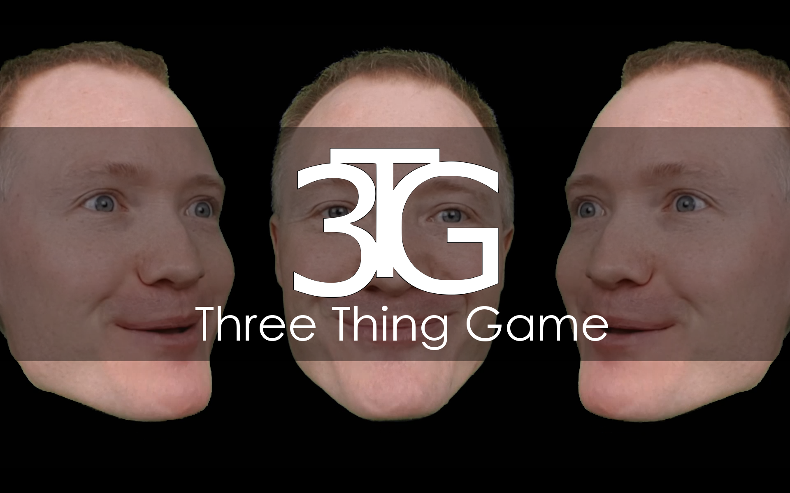

Computer Science
School of Engineering and Computer Science
Pizza sponsored by APD Communications
Graduate engineer vacancies here: www.apdcomms.com/careers
They will also be sending an alumni team to take part and answer questions that you may have about working at APD

